Slide 1
The Perfect Storm

Slide 2
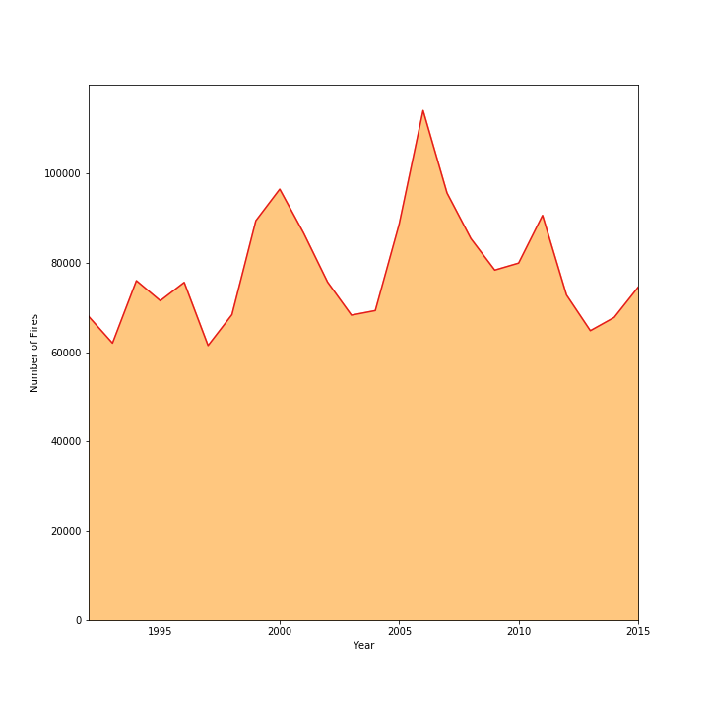
Total Fires Between 1992 and 2015

Slide 3
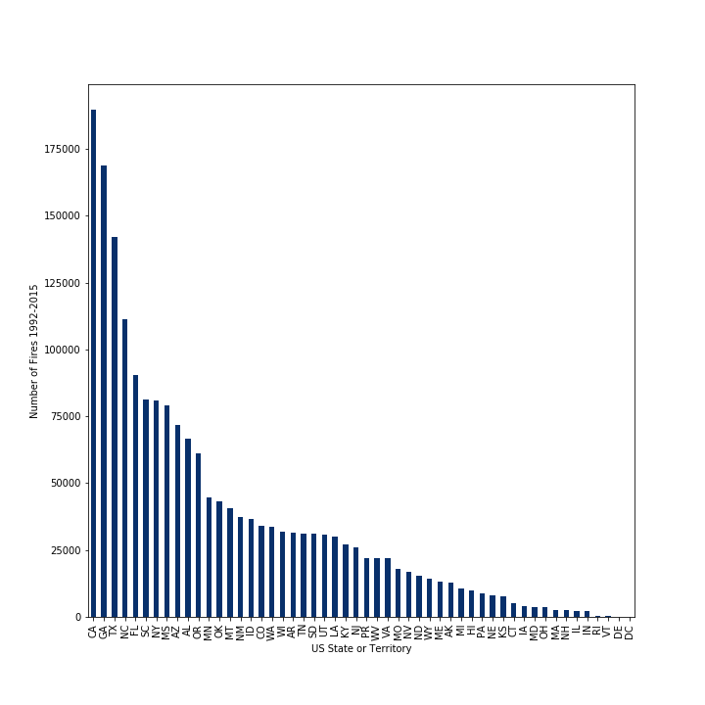
Total Fires by US Sate or Territory

Slide 4
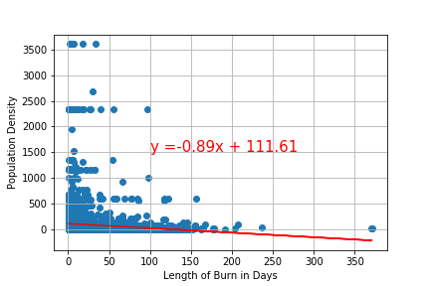
Population Density vs Length of Burn in Days r squared = -0.09559

Slide 5
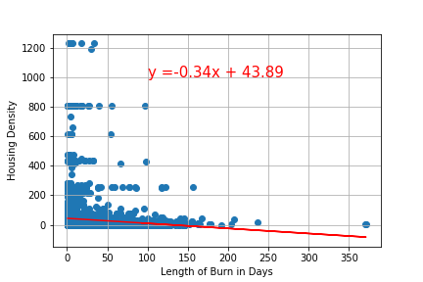
Housing Density vs Length of Burn in Days r squared = -0.1009

Slide 6
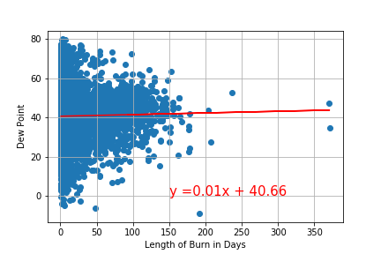
Dewpoint vs Length of Burn r squared = 0.0202

Slide 7
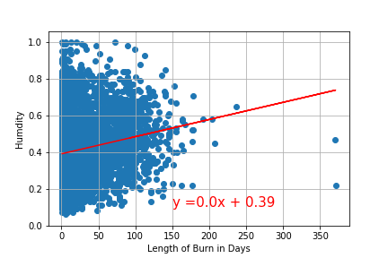
Humidity vs Length of Burn r squared = 0.1704

Slide 8
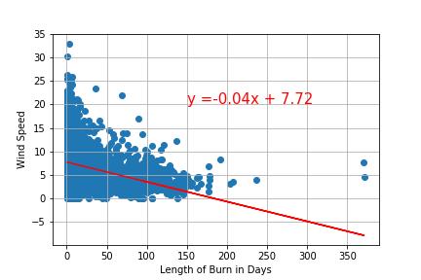
Wind Speed vs Length of Burn r squared = -0.3443

Slide 9
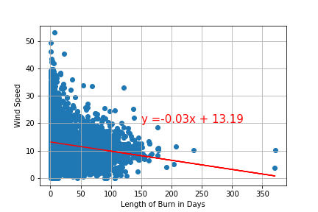
Average Wind Speed vs Length of Burn r squared = -0.1454

Slide 10
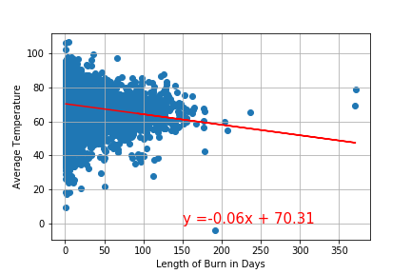
Average Temperature vs Length of Burn r squared = -0.1681

Slide 11
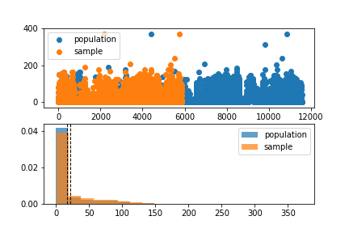
Wind speed – pvalue = 2.95607

